Slide 1
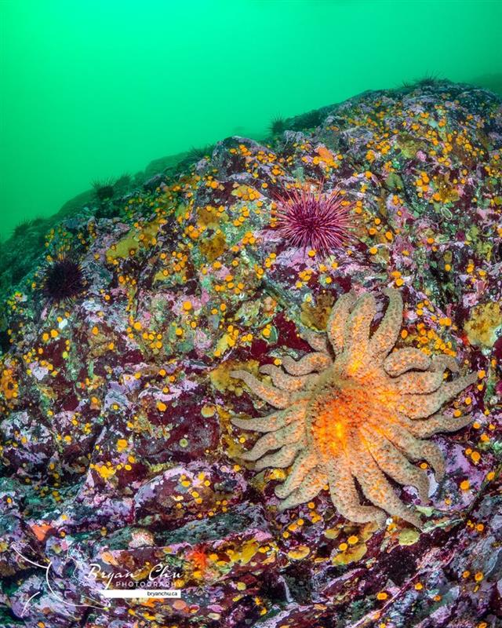
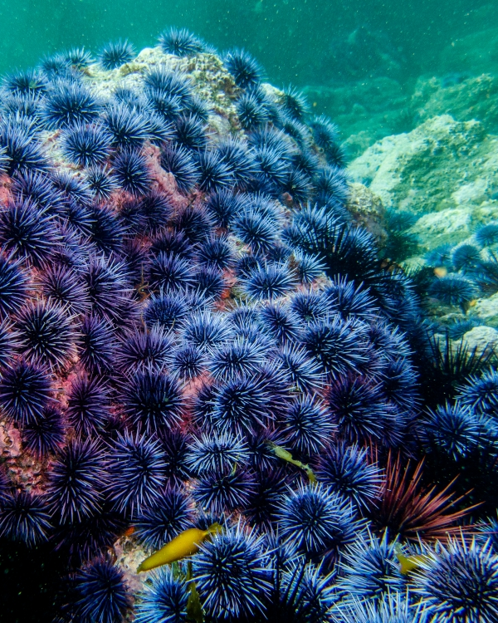
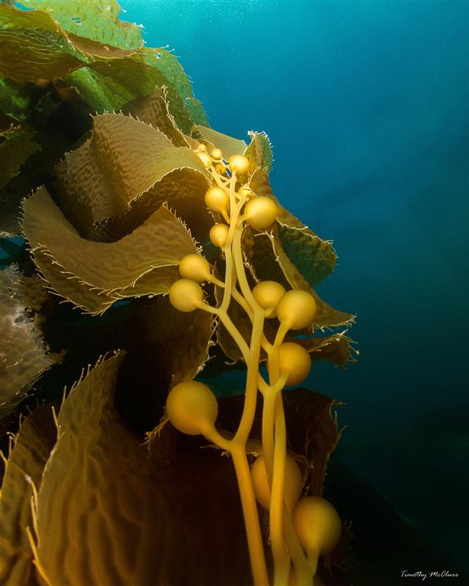
San Miguel Island RecentCommunity Changes
Kelp Forest Monitoring Program

Slide 2
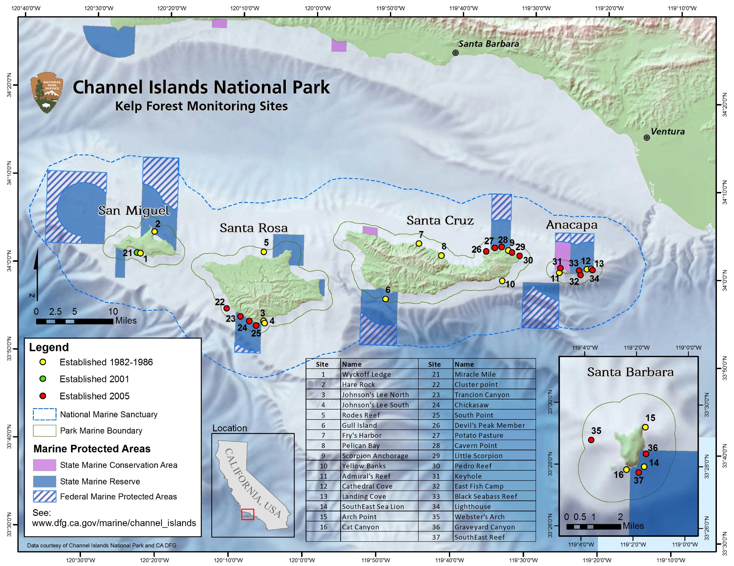

Slide 3
San Miguel Island KFM History
Remote Island with 2 original sites
Miracle Mile was added in 2001
No reserve reference sites
Cold water island, typically surveyed end of season

Slide 4
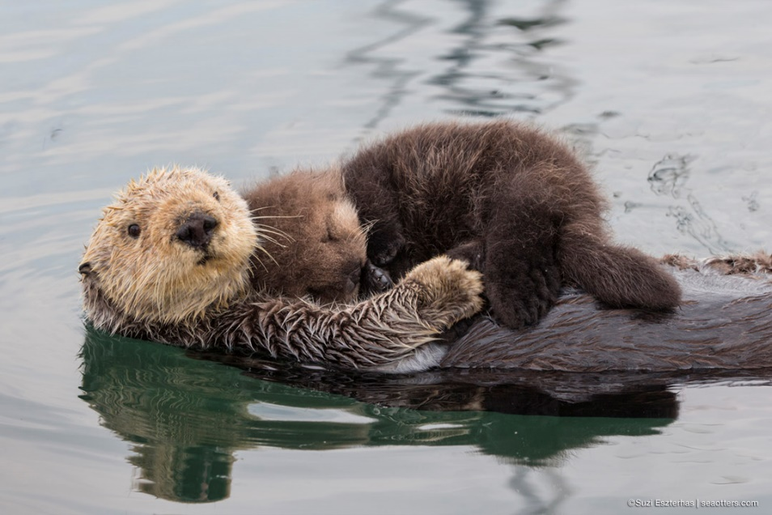
San Miguel Island Predators
Historic
Sea otters
Current
Sea stars

Slide 5
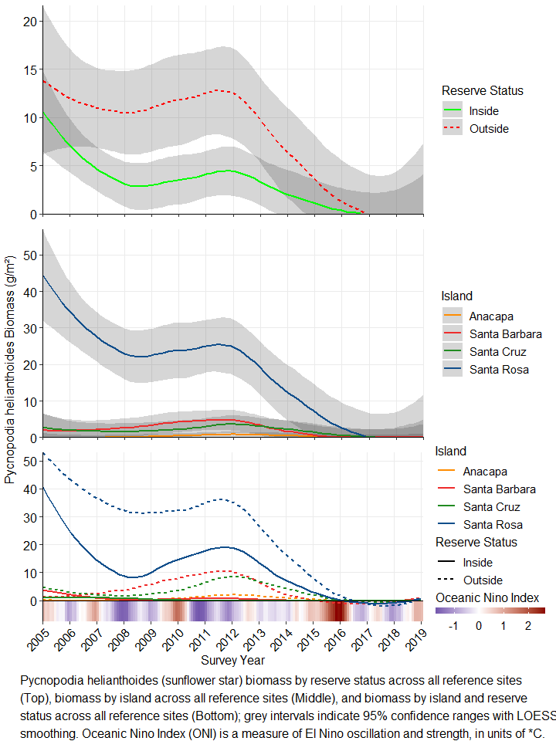

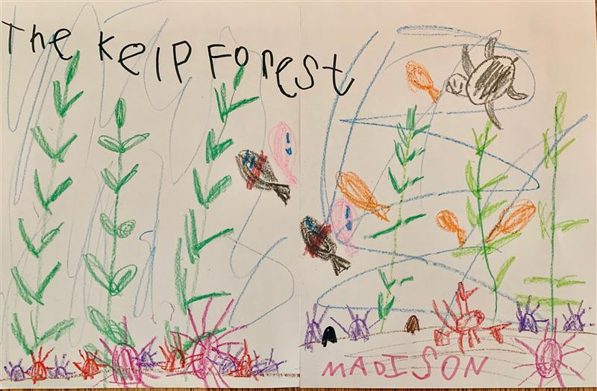
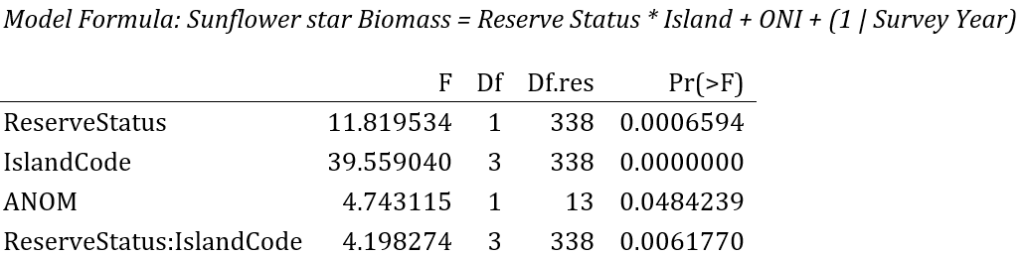
Sunflower Star Biomass
Statistically significant effects of reserve, island, and their interaction
Cold water urchin predator
Blob and Sea Star Wasting Disease in 2013 -> population collapse

Slide 6
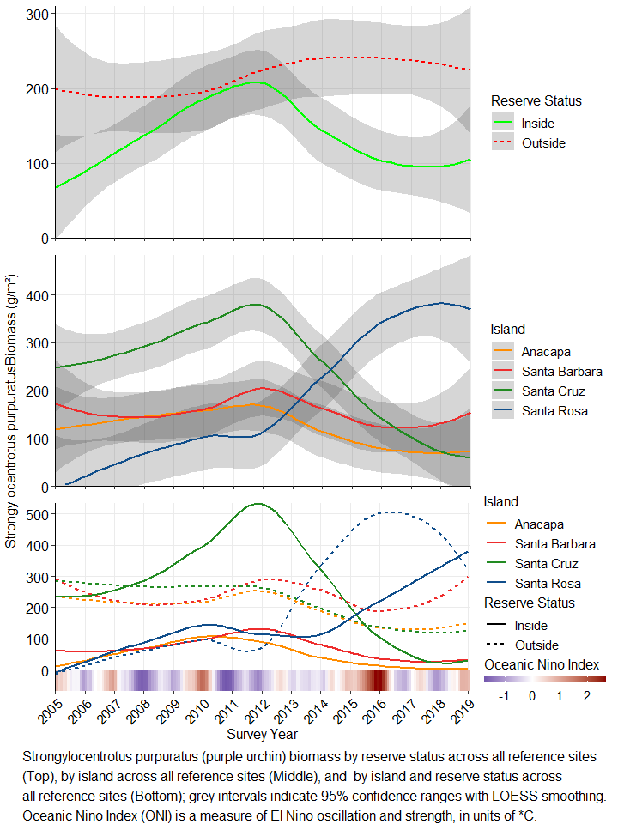
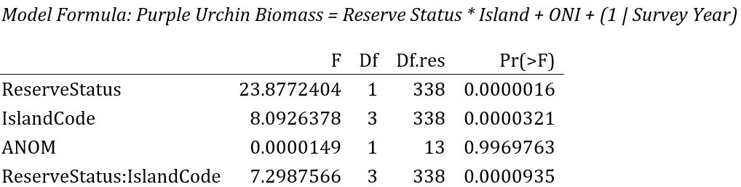
Purple Urchin Biomass
Significant effects of Reserve Status, Island Code, and their interaction
Increase at SRI in biomass outside of MPAs post-blob, decreases at warmer islands (SCI, ANI, SBI)
Increase in biomass greatest at SRI outside MPAs

Slide 7
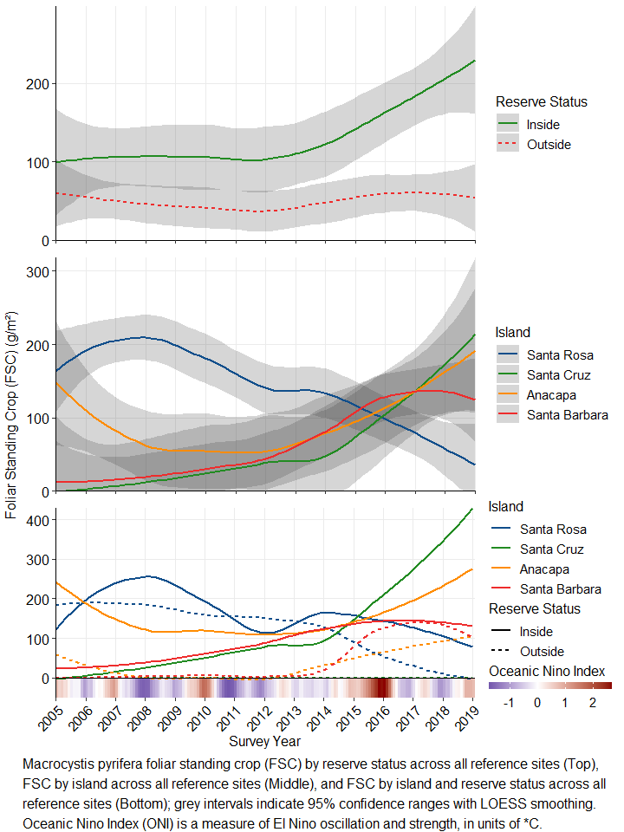

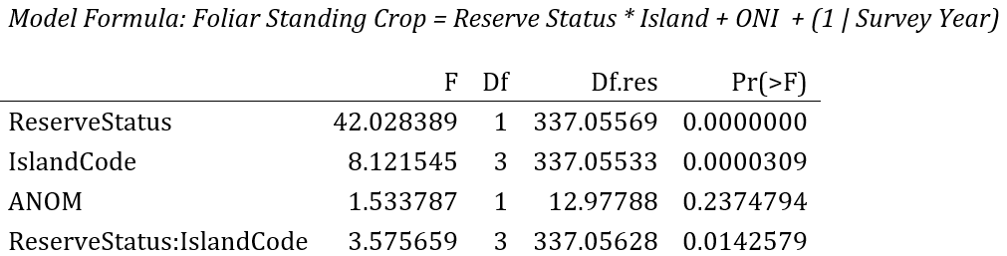
Giant Kelp Biomass
Significant effects of Reserve Status, Island Code, and their interaction
Recent significant increase in kelp inside MPAs
Kelp biomass generally similar between islands, except previously higher at SR

Slide 8
Conclusions
Effects via Trophic Cascades on MPAs are apparent
Outside MPAs:
sunflower stars were more abundant prior to their decline (particularly at SRI)
purple urchin biomass has since increased (particularly at SRI)
kelp biomass has not increased in general, and has decreased at SRI
Inside MPAs:
Sunflower stars declined
Purple urchin biomass at SRI has not increased at the same rate as outside MPAs
Kelp inside MPAs at SRI has not decreased at the same rate as outside MPAs
Other urchin predators:
Urchin biomass at warmer islands (SCI, ANI, SBI) have decreased inside MPAs, kelp biomass has increased inside MPAs
Fishing protections for California sheephead and California spiny lobster
Notes:
Tim

Slide 9
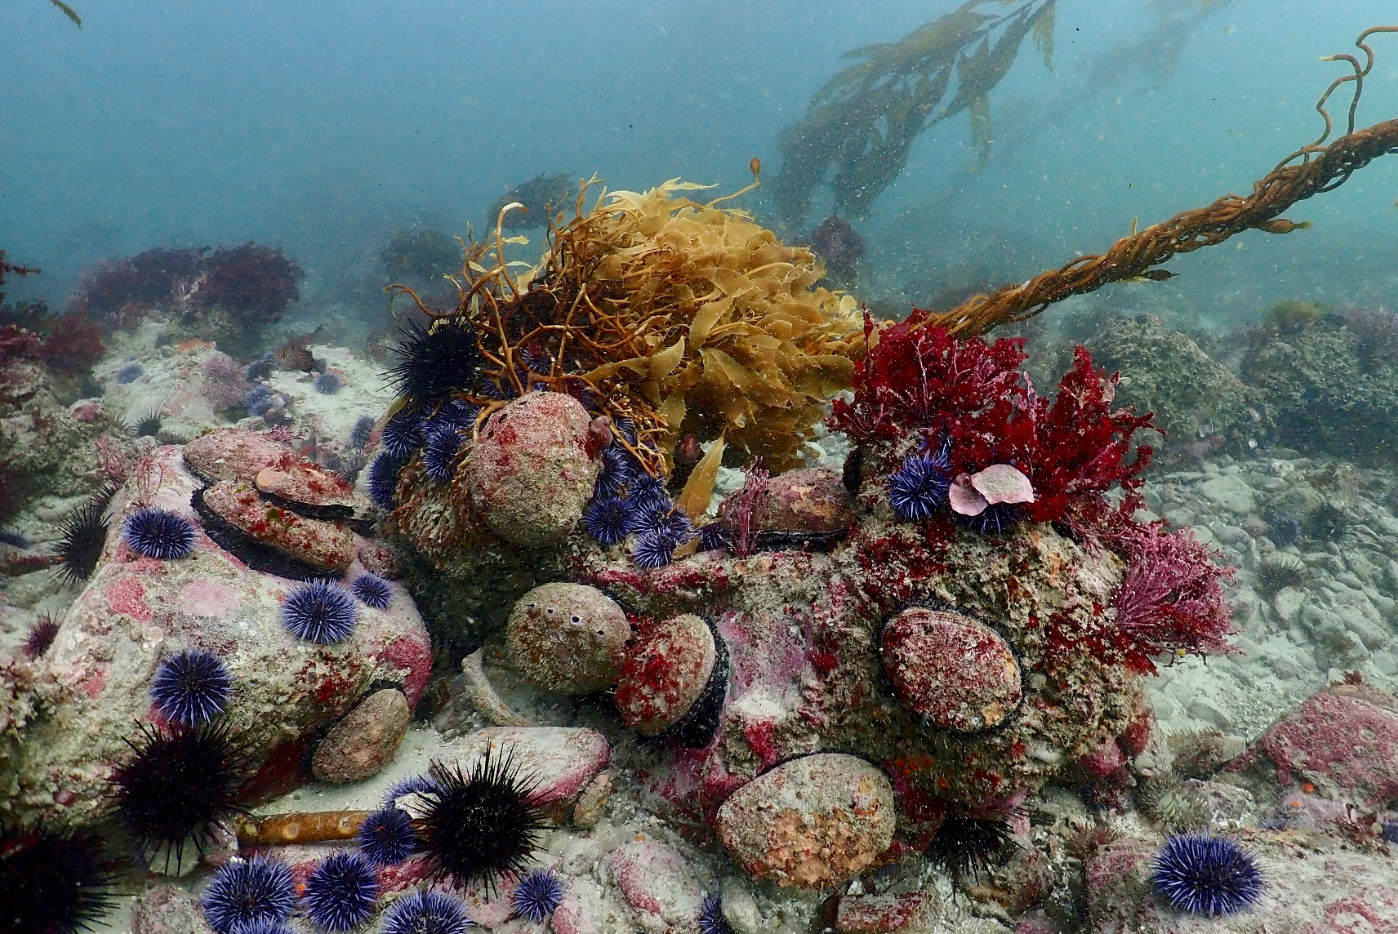
Abalone and urchins competing

Slide 10
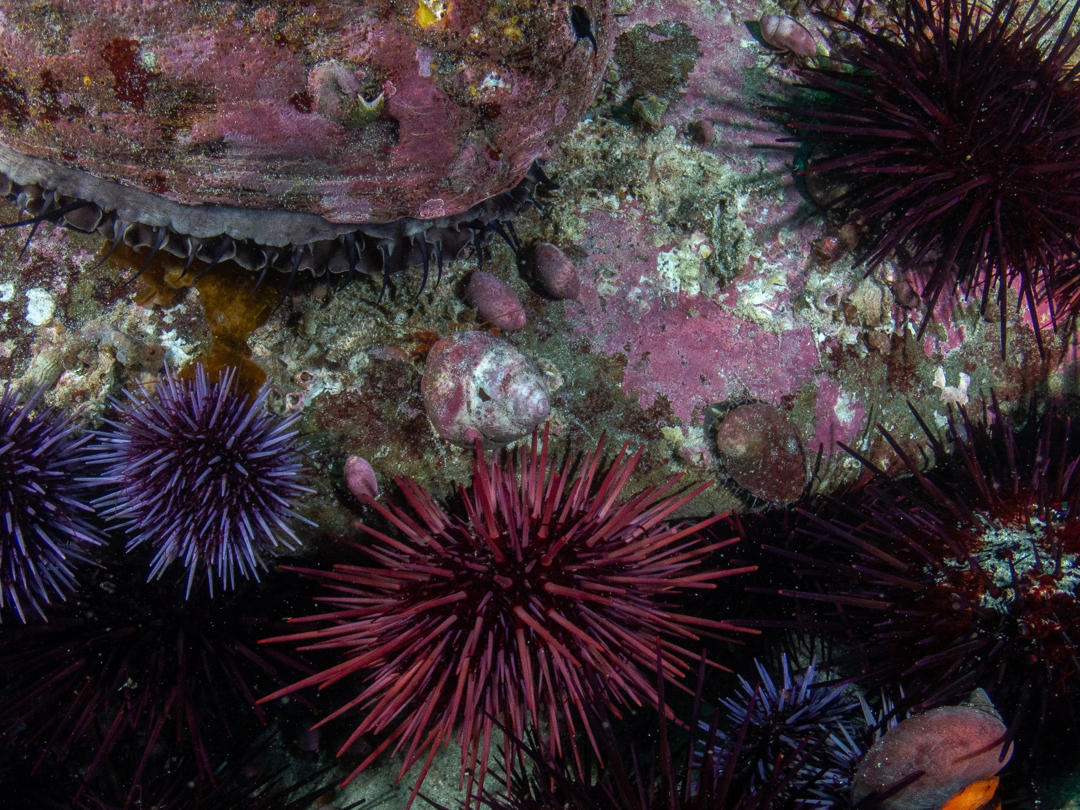
Juvenile abalone emerge to forage

Slide 11
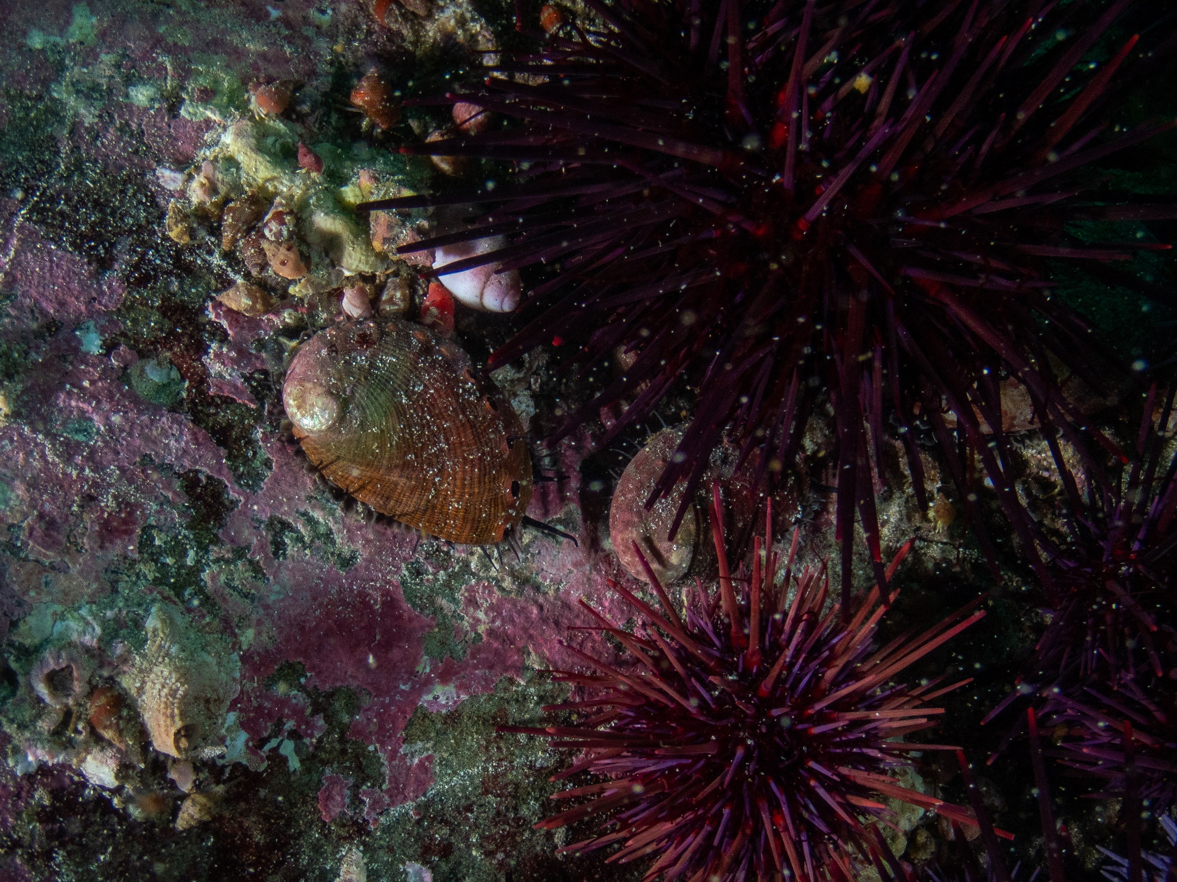

Slide 12
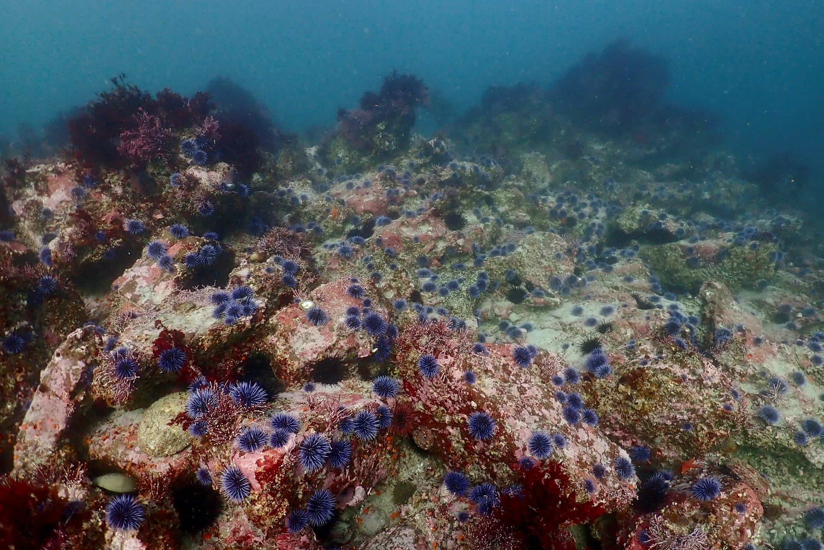
Urchins winning

Slide 13
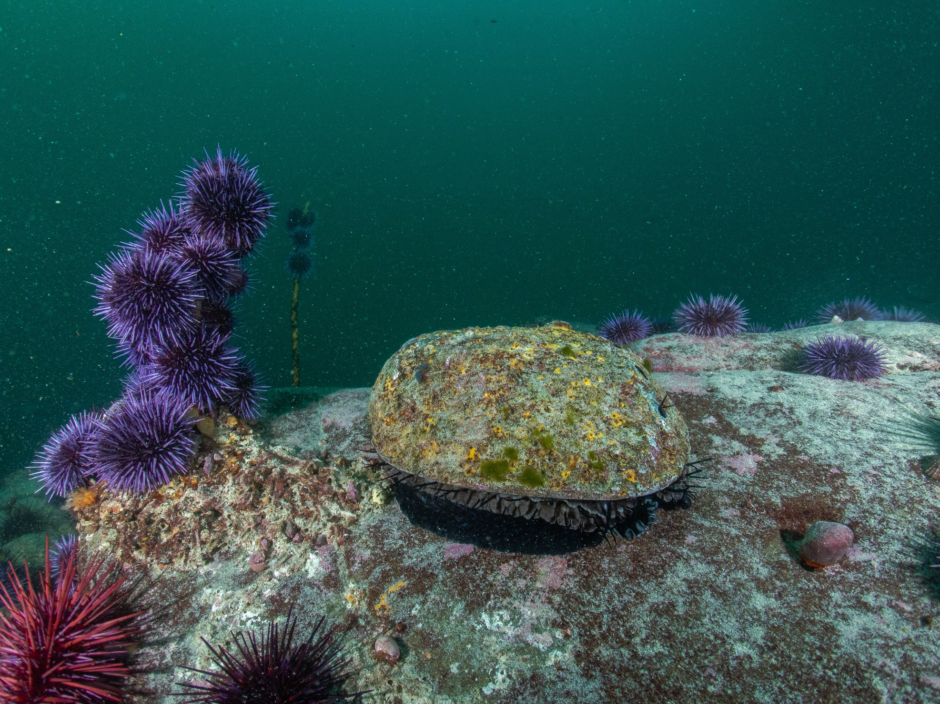

Slide 14
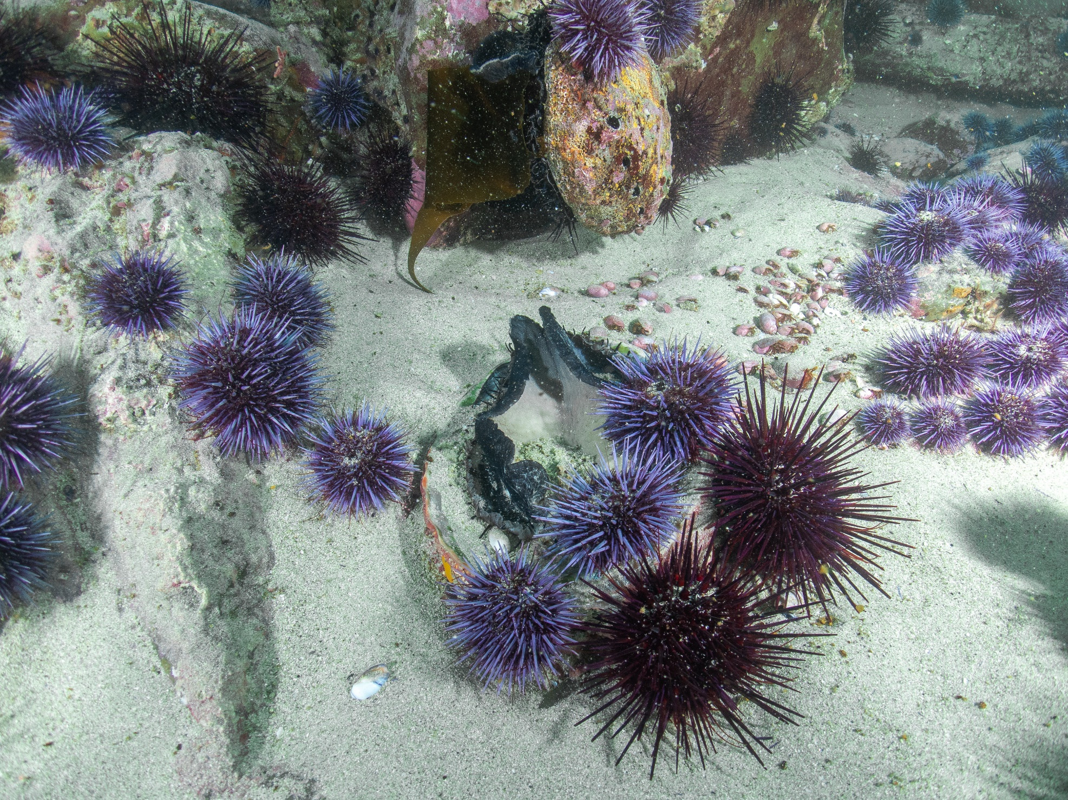

Slide 15
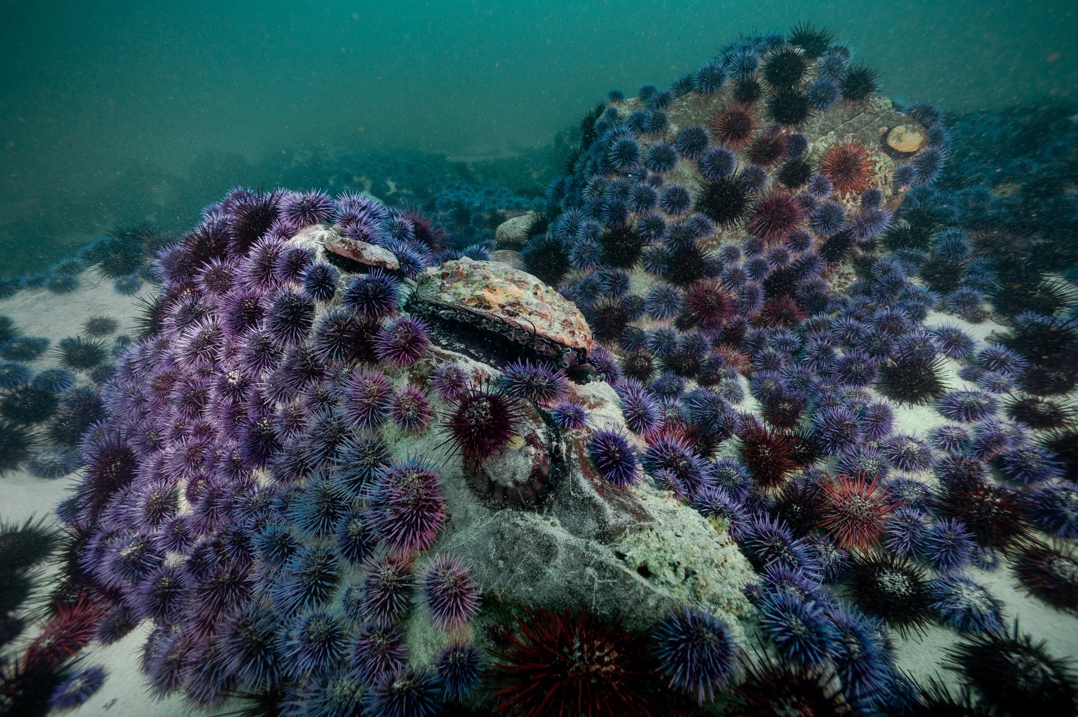

Slide 16
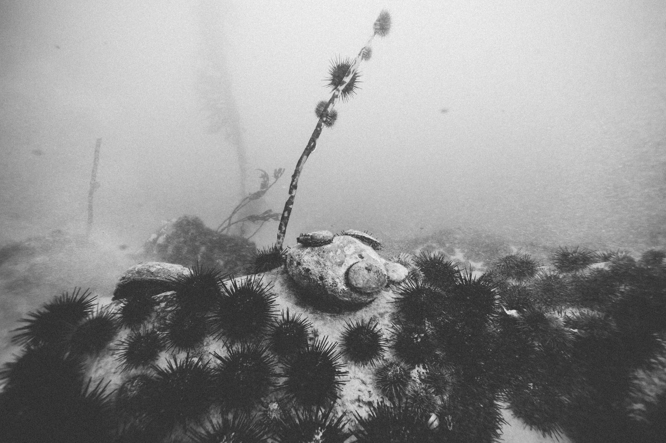

Slide 17
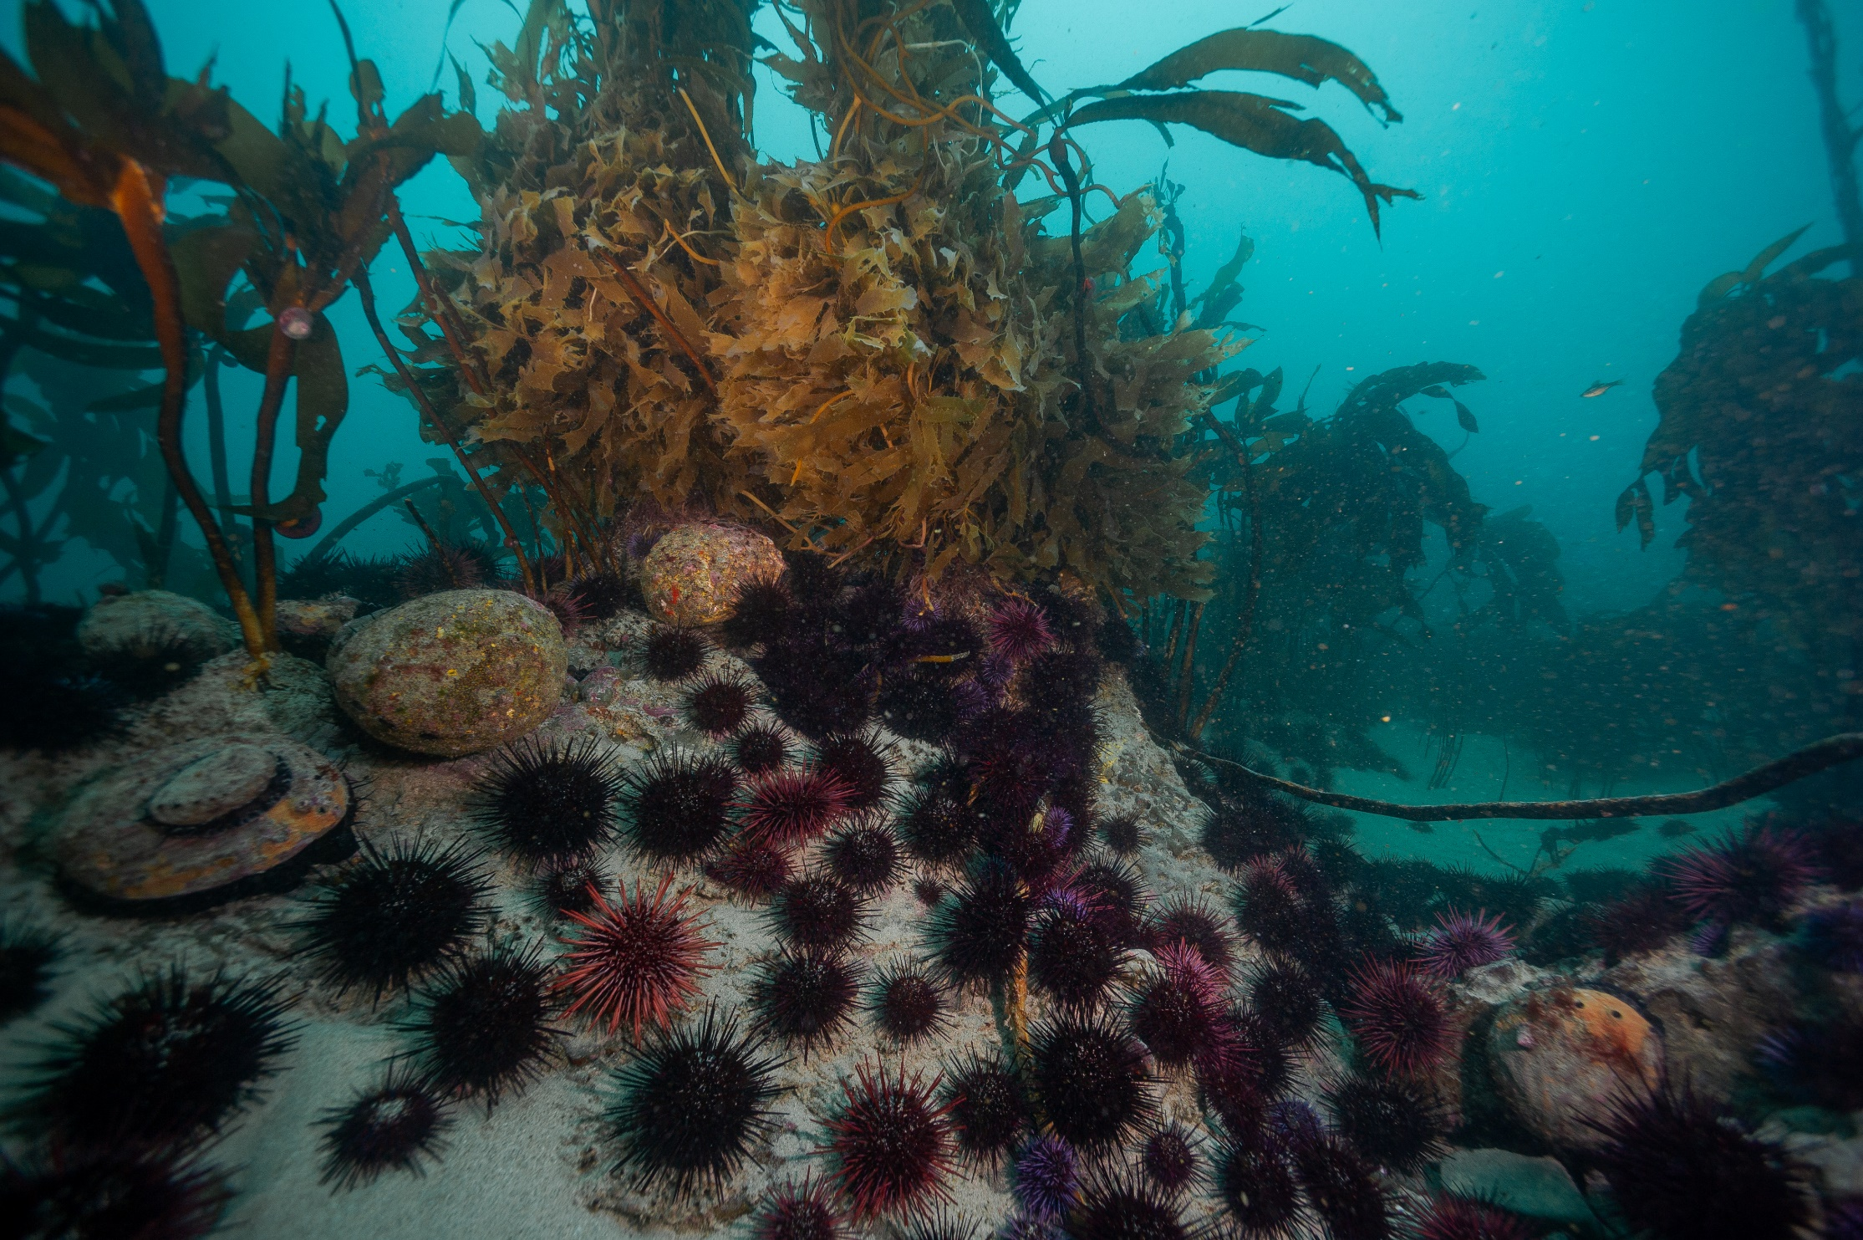

Slide 18
Next Week: San Miguel Island Community Changes

